Slide 1

CSC 223 LECTURE 5 DATA STRUCTURES
DR. ZUBAIR ADAM
DEAPARTMENT OF COMPUTER SCIENCE
LAGOS STATE UNIVERSITY

Slide 2
Elementary Data Structures
Overview on simple data structures
for representing dynamic sets of data records
Data structures are fundamental concepts in computer science that enable efficient organization, storage, and manipulation of data
Main operations on these data structures are
Insertion and deletion of an element
searching for an element
finding the minimum or maximum element
finding the successor or the predecessor of an element
And similar operations …
These data structures are often implemented
using dynamically allocated objects and pointers

Slide 3
Elementary Data Structures
Typical Examples of Elementary Data Structures
Array
Stack
Queue
Linked List
Tree

Slide 4
Elementary Data Structures
Stack
A stack implements the LIFO (last-in, first-out) policy
like a stack of plates, where you can either place
an extra plate at the top or remove the topmost plate
For a stack,
the insert operation is called Push
and the delete operation is called Pop

Slide 5
Elementary Data Structures
Where are Stacks used?
A call stack that is used for the proper execution
of a computer program with subroutine or function calls
Analysis of context free languages (e.g. properly nested brackets)
Properly nested: (()(()())), Wrongly nested: (()((())
Reversed Polish notation of terms
Compute 2 + 3*5 ⇨ 2 Push 3 Push 5 * +

Slide 6
Elementary Data Structures
Properties of a Stack
Stacks can be defined by axioms based on the stack operations,
i.e. a certain data structure is a stack if the respective axioms hold
For illustration some examples for such axioms - the “typical” axioms are
(where S is a Stack which can hold elements x of some set X)
If not full(S): Pop(S) o (Push(S,x)) = x for all x ∊ X
If not empty(S): Push(S, Pop(S)) = S

Slide 7
Elementary Data Structures
Typical Implementation of a Stack
A typical implementation of a stack of size n is based on an array S[1…n]
so it can hold at most n elements
top(S) is the index of the most recently inserted element
The stack consists of elements S[1 … top(S)], where
Push Pop
Top
4
3
2
1
S[1] is the element at the bottom of the stack,
and S[top(S)] is the element at the top.
The unused elements S[top(S)+1 … n] are not in the stack
S

Slide 8
Elementary Data Structures
Stack
If top(S) = 0 the stack is empty ⇨ no element can be popped
If top(S) = n the stack is full ⇨ no further element can be pushed

Slide 9
Elementary Data Structures
Example (Stack Manipulation)
S
Start with stack given,
denote changes of “stack state”
7
6
Push(S, 17)
Pop(S), Pop(S), Pop(S), Push(S, 5)
Pop(S), Pop(S)
Pop(S)
5
4
3
3
top(S)
2
23
1
3

Slide 10
Elementary Data Structures
pop (S) 17
pop (S) 3
pop (S) 23 push(S,5)
pop (S)
pop (S)
5
3
S:
push(S,17)
pop (S)
S:
S:
S:
3
23
3
7
6
5
4
3
2
1
17
3
23
3
7
6
5
4
3
2
1
5
3
7
6
5
4
3
2
1
7
6
5
4
3
2
1
Error: underflow
Top=4
Top[S]=3
Top=2
Top=0

Slide 11
Elementary Data Structures
Pseudo Code for Stack Operations
Number of elements
NumElements (S) return top[S]

Slide 12
Elementary Data Structures
Pseudo Code for Stack Operations
Test for emptiness
Stack_Empty(S) if top[S]=0
then return true else return false
Test for “stack full”
Stack_Full (S) if top[S]=n
then return true else return false

Slide 13
Elementary Data Structures
Pseudo Code for Stack Operations
Pushing and Popping
This pseudo code contains error handling functionality
Push(S,x)
if Stack_Full(S)
then error "overflow" else top[S] := top[S]+1
S[top[S]] := x
Pop(S)
if Stack_Empty(S)
then error "underflow" else top[S] := top[S]-1
return S[top[S]+1]

Slide 14
Elementary Data Structures
Pseudo Code for Stack Operations
(Asymptotic) Runtime
NumElements:
number of operations independent of size n of stack
constant ⇨ O(1)
Stack_Empty and Stack_Full:
number of operations independent of size n of stack
constant ⇨ O(1)
Push and Pop:
number of operations independent of size n of stack
constant ⇨ O(1)

Slide 15
Elementary Data Structures
Queue
A queue implements the FIFO (first-in, first-out) policy
Like a line of people at the post office or in a shop
enqueue
dequeue
tail head
For a queue,
the insert operation is called Enqueue
(=> place at the tail of the queue)
and the delete operation is called Dequeue
(=> take from the head of the queue)

Slide 16
Elementary Data Structures
Where are Queues used?
In multi-tasking systems (communication, synchronization)
In communication systems (store-and-forward networks)
In servicing systems (queue in front of the servicing unit)
Queuing networks (performance evaluation of computer and communication networks)

Slide 17
Elementary Data Structures
Typical Implementation of a Queue
A typical implementation of a queue consisting of at most n-1 elements is based on an array Q[1 … n]
Its attribute head(Q) points to the head of the queue.
Its attribute tail(Q) points to the position
where a new element will be inserted into the queue (i.e. one position behind the last element of the queue).
The elements in the queue are in positions
head(Q), head(Q)+1, …, tail(Q)-1, where we wrap around the array boundary in the sense that Q[1] immediately follows Q[n]

Slide 18
Elementary Data Structures
Example (1)
1 2 3 4 5 6 7 8 9 10
Q
 |  |  |  |  | 1. | 2. | 3.
(n = length (Q) = 10)
head(Q)
tail(Q)
Insert a new element (4.)
1 2 3 4 5 6 7 8 9 10
Q
 |  |  |  |  | 1. | 2. | 3. | 4.
head(Q)
tail(Q)

Slide 19
Elementary Data Structures
Example (2)
1
2 3 4 5 6 7 8 9 10
Q
 |  |  |  |  | 1. | 2. | 3. | 4.
Insert one more element (5.) ^{head(Q)}
tail(Q)
1 2 3 4 5 6 7 8 9 10
Q
tail(Q) head(Q)
And again: Insert one more element (6.)
1 2 3 4 5 6 7 8 9 10
Q
 |  |  |  |  | 1. | 2. | 3. | 4. | 5.
6. |  |  |  |  | 1. | 2. | 3. | 4. | 5.
tail(Q)
head(Q)

Slide 20
Elementary Data Structures
Typical Implementation of a Queue
Number of elements in queue
If tail > head:
NumElements(Q) = tail - head
If tail < head:
NumElements(Q) = tail – head + n
If tail = head:
NumElements(Q) = 0
Initially: head[Q] = tail[Q] = 1
Position of elements in queue
The x. element of a queue Q (1 ≤ x ≤ NumElements(Q) is mapped to array position
head(Q) + (x - 1)
head(Q) + (x - 1) - n
if x ≤ n – head +1 (no wrap around) if x > n – head +1 (wrap around)

Slide 21
Elementary Data Structures
Typical Implementation of a Queue
Remark:
A queue implemented by a n-element array can hold at most n-1 elements
otherwise we could not distinguish between an empty and a full queue
A queue Q is empty:
if head(Q) = tail(Q)
(⇔ NumElements(Q) = 0)
A queue Q is full:
(⇔ NumElements(Q) = n-1)
(head(Q) > tail(Q))
if head(Q) = (tail(Q) + 1)
if head(Q) = (tail(Q) - n + 1) (head(Q) < tail(Q))

Slide 22
Elementary Data Structures
Example (Queue Manipulation)
1 2 3 4 5 6 7 8 9 10
Q
head(Q) tail(Q)
Start with queue given, denote changes of “queue state”
Enqueue(Q, 2), Enqueue(Q, 3), Enqueue(Q, 7)
Dequeue(Q)
 |  |  |  |  | 4 | 12 | 4

Slide 23
Elementary Data Structures
Queue Operations
This pseudo code does not contain error handling functionality
(see stack push and pop)
Enqueue and Dequeue
Enqueue(Q,x)
Q[tail[Q]] := x
if tail[Q]=length[Q] then tail[Q] := 1
Precondition: queue not full
else tail[Q] := tail[Q]+1
Dequeue(Q)
x := Q[head[Q]]
if head[Q]=length[Q] then head[Q] := 1
Precondition: queue not empty
else head[Q] := head[Q]+1 return x

Slide 24
Elementary Data Structures
Typical Examples of Elementary Data Structures
Array
Stack
Queue
Linked List
Tree

Slide 25
Elementary Data Structures
Linked List
In a linked list, the elements are arranged in a linear order,
i.e. each element (except the first one) has a predecessor and each element (except the last one) has a successor.
Unlike an array, elements are not addressed by an index, but by a pointer (a reference).
There are singly linked lists and doubly linked lists.
A list may be sorted or unsorted.
A list may be circular (i.e. a ring of elements).
Here we consider mainly unsorted, doubly linked lists

Slide 26
Elementary Data Structures
Linked List
Each element x of a (doubly) linked list has three fields
A pointer prev to the previous element
A pointer next to the next element
A field that contains a key (value of a certain type)
Possibly a field that contains satellite data (ignored in the following)
prev key next
One element x :
(consist of 3 fields)
Pointer fields that contain no pointer pointing to another element contain the special pointer NIL (∖)
The pointer head[L] points to the first element of the linked list
If head[L] = NIL the list L is an empty list

Slide 27
Elementary Data Structures
Linked List
In a linked list, the insert operation is called List_Insert, and the delete operation is called List_Delete.
In a linked list we may search for an element with a certain key k by calling List_Search.
Linked List Example: dynamic set {11, 2 ,7 , 13}
prev
key next
head[L]
7
13
2
11
Notice:
prev[head] = NIL and next[tail] = NIL

Slide 28
Elementary Data Structures
Some Examples for the Use of Linked Lists
Lists of passengers of a plane or a hotel
Card games (sorting cards corresponding to a certain order, inserting new cards into or removing cards out of the sequence)
To-do lists (containing entries for actions to be done)
Hash Lists (⇨ Hashing, dealt later in this lecture)

Slide 29
Elementary Data Structures
Searching a Linked List
The procedure List_search (L, k) finds the first element with key k in list L and returns a pointer to that element.
If no element with key k is found, the special pointer NIL is returned.
List_Search(L,k) x := head[L]
while x!=NIL and key[x]!=k do x := next[x]
return x
It takes at most Θ(n) time to search a list of n objects (linear search)

Slide 30
Elementary Data Structures
Inserting into a Linked List
The procedure List_insert(L,x) inserts a new element x as the new head of list L
List_Insert(L,x) next[x] := head[L] if head[L]!=NIL then
prev[head[L]] := x head[L] := x
prev[x] := NIL
x
key(x)
head[L]
The runtime for List_Insert on a list of length n is constant (O(1))

Slide 31
Elementary Data Structures
Deleting from a Linked List
The procedure List_Delete (L, x) removes an element x from the linked list L, where the element is given by a pointer to x.
If you want to delete an element given by its key k, you have to compute a pointer to this element (e.g. by using List_search(L, k))
List_Delete(L,x) if prev[x]!=NIL
x not the first element
then next[prev[x]] := next[x] else head[L] := next[x]
if next[x]!=NIL
x not the last element
then prev[next[x]] := prev[x]

Slide 32
Elementary Data Structures
Deleting from a Linked List
List_Delete(L,x)
a)
if prev[x]!=NIL
then next[prev[x]] := next[x] else head[L] := next[x]
if next[x]!=NIL
then prev[next[x]] := prev[x]
–^{x} –
b)
a)
head[L]
–^{x} –
b)
head[L]

Slide 33
Elementary Data Structures
Deleting from a Linked List
The runtime for List_Delete on a list of length n is constant (O(1))
If you want to delete an element with a certain key, you must first find that element by executing List_Search, which takes Θ(n) time in the worst case

Slide 34
Elementary Data Structures
Inserting and deleting :
head[L]
7 13
List_insert (L,x) with key[x] = 25
2
11
head[L]
25
7
13
2
11
List_Delete (L,x) where x points to element with key[x] = 2
head[L]
25
7
13
11

Slide 35
Elementary Data Structures
Tree
Any data structure consisting of elements of the same type can be represented with the help of pointers
(in a similar way as we implemented lists).
Very important examples of such data structures are trees.
Trees are graphs that contain no cycle:
every non-trivial path through a tree starting at a node and ending in the same node, does traverse at least one edge at least twice.
There exist many kinds of trees. Examples are:
Binary trees
Trees with unbounded branching
Binary search trees
Red-black trees

Slide 36
Elementary Data Structures
Some Examples for the Use of Trees
Systematically exploring various ways of proceeding (e.g. in chess or planning games)
Morse trees (coding trees)
Heaps (⇨ heap sort)
Search trees

Slide 37
Elementary Data Structures
Tree
A binary tree consists of nodes with the following fields
A key field
Possibly some satellite data (ignored in the following)
Three pointers p, left and right pointing to the parent node, left child node and right child node
Be x an element (or node) of a tree
If p[x] = NIL ⇨ x represents the root node
If both left[x] = NIL and right[x] = NIL
x represents a leaf node
For each tree T there is a pointer root[T] that points to the root of T
If root[T] = NIL, the tree T is empty

Slide 38
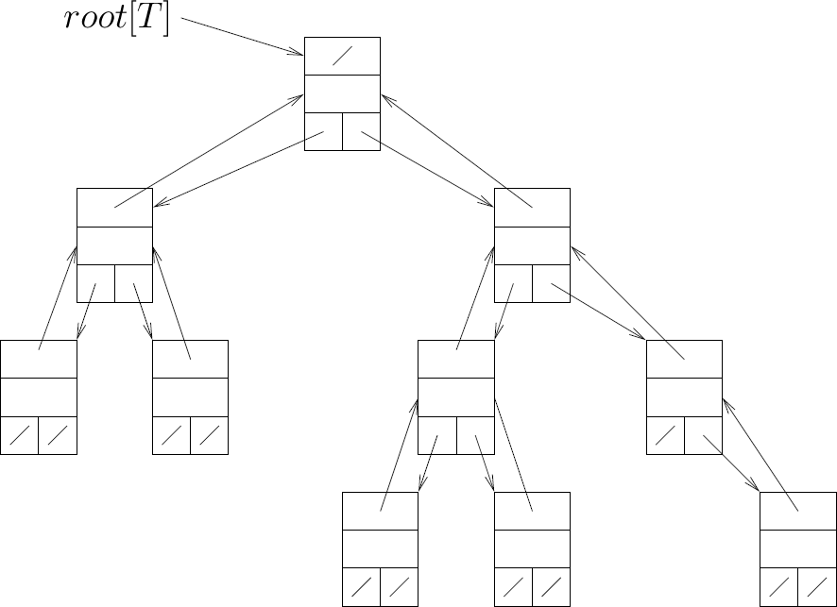
Elementary Data Structures
Binary Tree (Example)
p
key (+ s.d.)
left | right

Slide 39
Elementary Data Structures
P-nary Trees
The above scheme can be extended to any class of trees where the number of children is bounded by some constant k : child₁ ,☹, child_{k}
k ∈ Ν
a bit of memory space may be wasted for pointers which are not actually used
Trees with unbounded branching
A tree with unbounded branching
(if no upper bound on the number of a node's children is known a priori) can be implemented by the following scheme:
Each node has a key field (and possibly some satellite data),
and three pointers p, left_child and right_sibling
In a leaf node, left_child=NIL
If a node is the rightmost child of its parent, then right_sibling=NIL

Slide 40
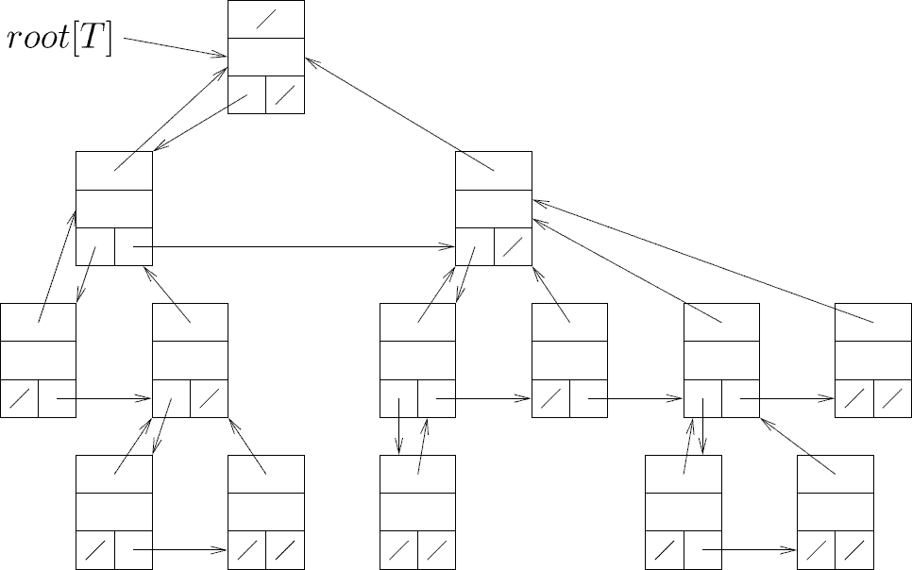
Elementary Data Structures
Unbounded Tree (Example)
p
key (+ s.d.)
l_child | r_sibl

Slide 41

















Elementary Data Structures
Unbounded Tree (Example)
leaves

